Slide 1
Friend Functions

Slide 2
Friend Function
A friend function is a function that can access the non-public members of a class, even though the function itself is not a member of the class.
A friend function is a normal function with special access privileges.
A friend function, as though not a member function , has full access rights to the private members of the class.

Slide 3
Friend function prototype should be placed inside the class definition (can be any where inside the class definition).
Friend function definition should be outside the class scope.
Even though the prototypes of friend functions appear in the class definition, friends are not member functions.
Unlike member functions, it cannot access the member names directly and has to use an object name and dot membership operator with each member name

Slide 4
To make an outside function "friendly" to a class, we have to simply declare this function as a friend of the classes as shown below :
class ABC
{
---------
---------
public:
--------
----------
friend void xyz(void);
};

Slide 5
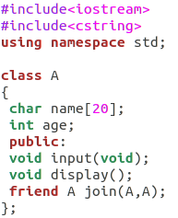
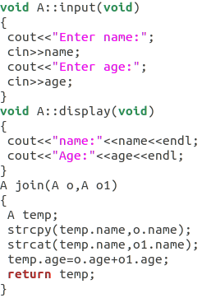
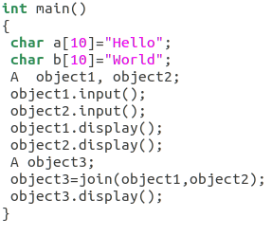
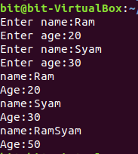
Sample example

Slide 6
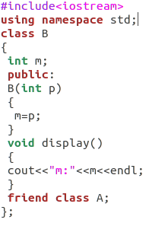
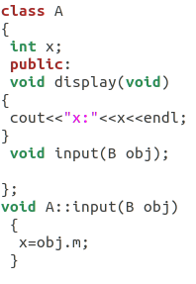
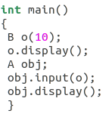

Friend class

Slide 7
Friends to more than One Class Act as Bridges
Imagine that you want a function to operate on objects of two different classes.
Perhaps the function will take objects of the two classes as arguments, and operate on their private data.

Slide 8
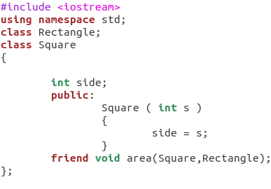
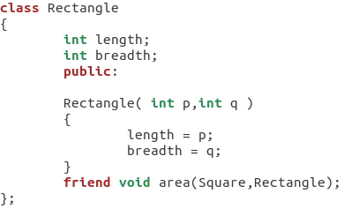
Sample example

Slide 9
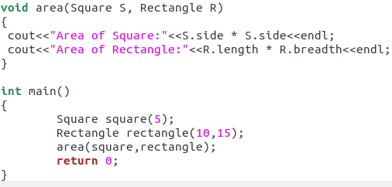

Contd.

Slide 10
Pointer and class
We can declare a pointer to an object as
item * ptr, where item is predefined class.
For example:
item x;
item *ptr;
ptr=&x;
We can access the member of x as follows.
ptr->member or
(*ptr).member

Slide 11
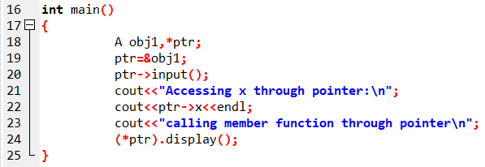
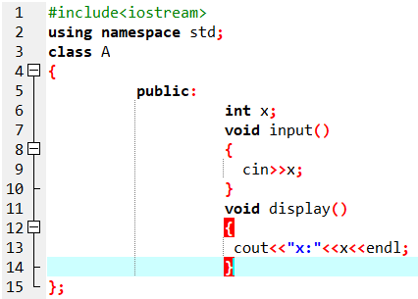
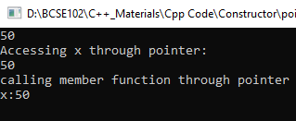
Example

Slide 12
“this” pointer
this pointer in C++ points to the object that invokes the member function. This keyword is only accessible within the nonstatic member functions of a class/struct/union type.
In C++, this pointer is used to represent the address of an object inside a member function. For example, consider an object obj calling one of its member function say method() as obj.method(). Then, this pointer will hold the address of object obj inside the member function method(). The this pointer acts as an implicit argument to all the member functions.

Slide 13
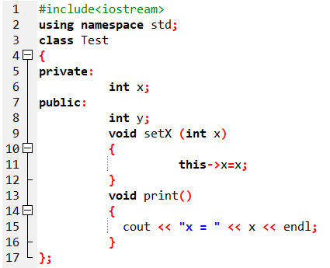
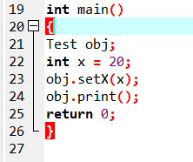
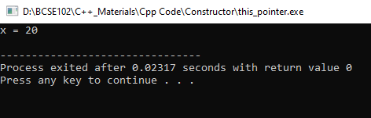
Same class variable and parameter names

Slide 14
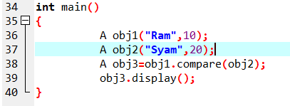
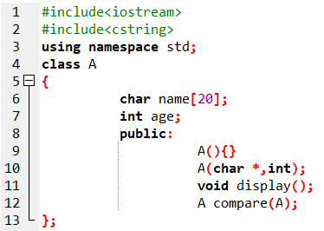
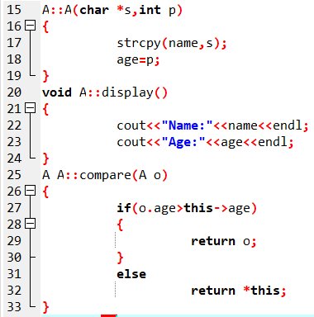

Returning the current object

